Slide 1

BACHELOR OF SCIENCE IN MATHEMATICS
CHRIST COLLEGE OF ARTS AND SCIENCE
DEPARTMENT OF MATHEMATICS

Slide 2
SUBSCRIBERS GALORE : EXPLORING WORLD’S TOP YOUTUBE CHANNELS
Submitted by
1.Angelin.R 222108726
2.Almas parveen.T 222108725
3.Mugilan.M 222108720
4.Thanesh vasanth.J 222108723
5.Chandramohan.E 222108719
Guided by
Mrs.A.PushpalathaM.sc.,M.Phil.,B.Ed.,
Assistant Professor.

Slide 3
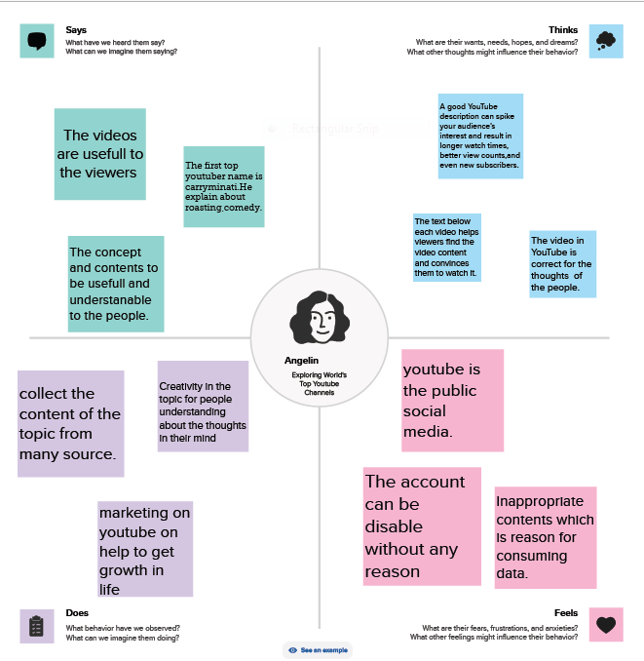
EMPATHY MAP

Slide 4
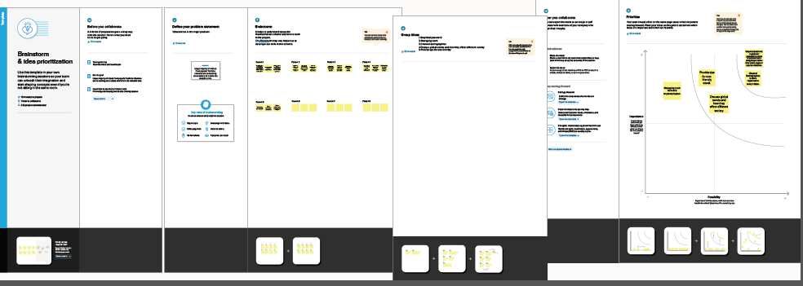
BRAIN STORMING

Slide 5
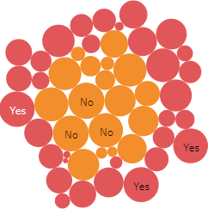

Slide 6
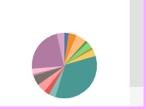

Slide 7
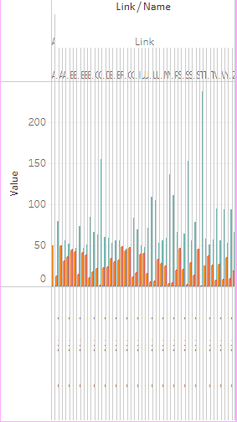

Slide 8
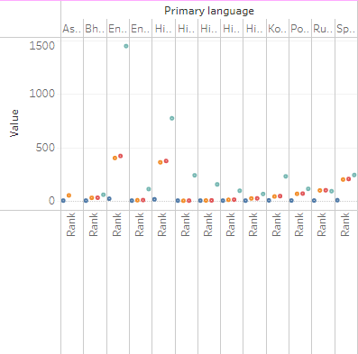

Slide 9
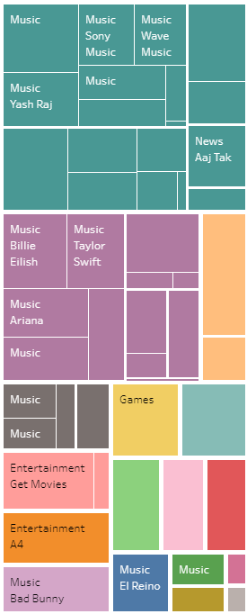

Slide 11
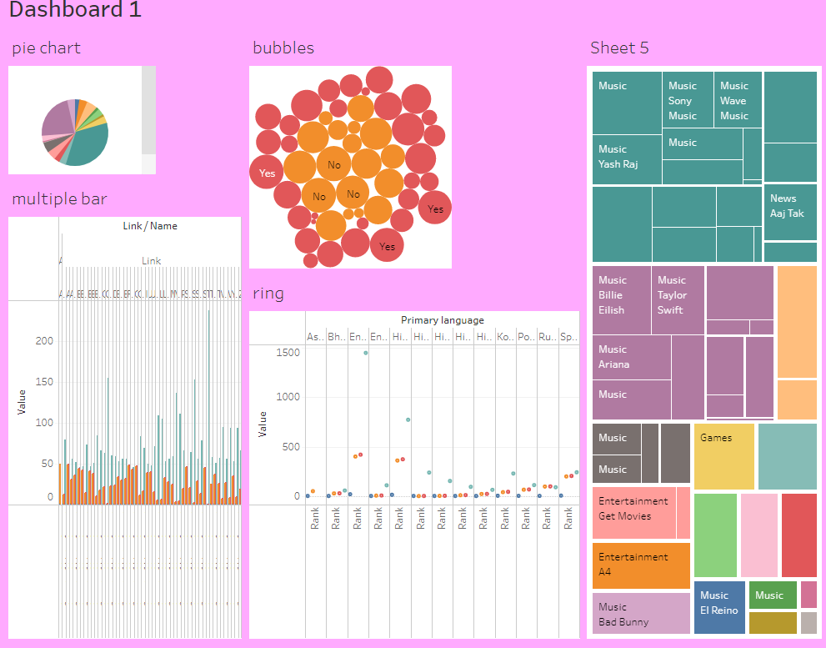

Slide 12
THANKYOU

